Slide 1


Building Blocks of Insurance: 45 Days of Proficiency
Embark on a comprehensive online training journey in General and Health Insurance with our 45-hour course. This program is designed to provide you with a solid foundation in insurance fundamentals, regulatory frameworks, and practical skills essential for success in the industry. Through a combination of recorded sessions, interactive webinars, and engaging case studies, you'll gain valuable insights and develop the expertise needed to excel in the dynamic world of insurance.
by Dr Sunanda Jha

Slide 2
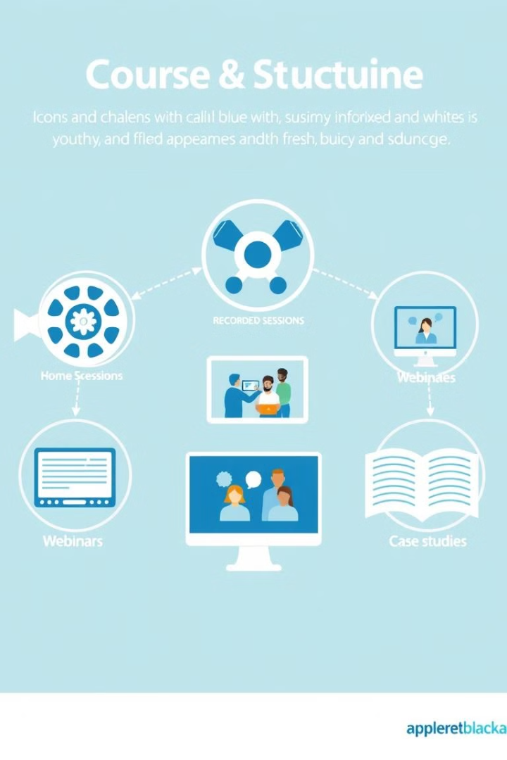
Course Structure and Objectives
1
Course Duration
45 Hours total, including 35 hours of recorded sessions, 5 hours of webinars, and 5 hours of case studies.
2
Key Objectives
Understand insurance fundamentals, gain regulatory insights, develop practical skills, and enhance customer service techniques.
3
Learning Approach
Combine theoretical knowledge with real-world applications through interactive sessions and case studies.

Slide 3

Introduction to Insurance
Overview of the Insurance Industry
Basic Concepts of Insurance
Explore the history, significance, and evolution of insurance in a 2-hour recorded session.
Delve into key terminology including premiums, coverage, and exclusions in a 3-hour recorded session.

Slide 4
General Insurance Fundamentals
Types of General Insurance
Property and Auto Insurance
Interactive Q&A
2-hour webinar for clarifying concepts and discussing real-world experiences.
Overview of property, auto, liability, and travel insurance in a 3-hour session.
Detailed exploration of coverage types, policies, and claims processes in two separate sessions.

Slide 5

Health Insurance Essentials
1
Overview of Health Insurance
3-hour session covering individual, group, and government programs.
2
Key Health Insurance Terms
3-hour deep dive into copayments, coinsurance, and out-of-pocket maximums.
3
Policies and Coverage Options
2-hour session on exclusions, limitations, and claims processes.
4
Trends and Innovations
2-hour webinar discussing telemedicine, digital health, and future trends.

Slide 6

Regulatory and Compliance Framework
1
Insurance Regulations Overview
2
Consumer Protection Laws
3
Compliance Requirements
2-hour session on the role of regulatory bodies like IRDAI and their impact on the industry.
3-hour deep dive into policyholder rights and ethical practices in insurance.
Detailed exploration of industry-specific compliance standards and best practices.

Slide 7




Customer Service and Sales Skills
Effective Communication
2-hour session on building rapport and active listening techniques in insurance.
Sales Techniques
3-hour exploration of consultative selling approaches and handling objections.
Interactive Role-Playing
1-hour webinar for practicing client interactions and sales pitches in real-time.

Slide 8

Practical Applications and Case Studies
Case Study 1
General Insurance Claims Process (2 hours)
Case Study 2
Health Insurance Policy Evaluation (2 hours)
Case Study 3
Compliance Breach Analysis (1 hour)

Slide 9
Course Materials and Assessment
Learning Resources
Self-Assessment
Final Evaluation
Access to recorded sessions, webinar recordings, supplemental reading materials, and case study documents.
Quizzes for self-evaluation after each module to reinforce learning.
Comprehensive assessment covering all modules, along with participation in webinars and case studies.

Slide 10

Additional Features and Networking
Discussion Forums
Resource Library
Networking Opportunities
Engage with peers and share insights on insurance topics.
Access additional materials and articles to deepen your knowledge.
Connect with industry professionals to expand your professional network.

